Slide 1



Harvesting Horizons: Predictive Modeling for Crop Loss and Their Telecoupled Supply Chain Impacts
Space Grant Intern: Aiden Harper
Mentor: Eric Sjöstedt (Ph.D. Candidate), Richard Rushforth (SICCS Faculty), Benjamin Ruddell (SICCS Faculty)

Slide 2
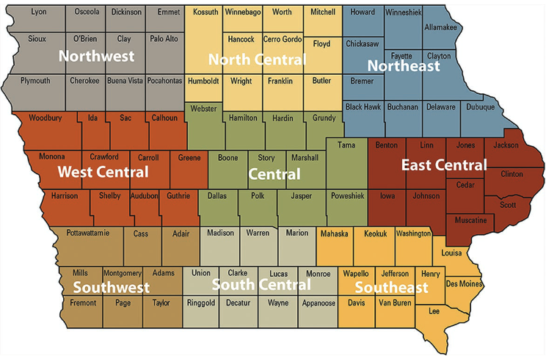
Background
Iowa consistently ranks as the leading state for corn production.
About 16% of the total U.S. corn output annually (Iowa State University).
A typical Iowa farm produces 201 bushels per acre (Iowa Corn Growers Association, ICGA).
The majority of Iowa corn production is field corn and not sweet corn (ICGA).
Field corn: livestock feed, ethanol manufacturing, other products.
Sweet corn: corn on the cob
Dean et al., 2021
Notes:
Massive Acreage: Roughly 13 million acres of farmland in Iowa are planted with corn each year, which is more than any other state.
National Food & Energy Security: Iowa corn is essential not just for food but for biofuel production (ethanol) and livestock feed, which influences prices and availability nationwide.
Economic Impact: Corn farming is a major driver of Iowa’s economy, supporting not just farmers but also ethanol plants, livestock feed industries, and global export markets.
https://agpolicyreview.card.iastate.edu/spring-2021/iowas-role-us-agriculture#:~:text=Through%20it%20all%2C%20Iowa's%20agricultural,in%20the%20nation%20behind%20Illinois.
https://www.iowacorn.org/corn-facts-faq/

Slide 3
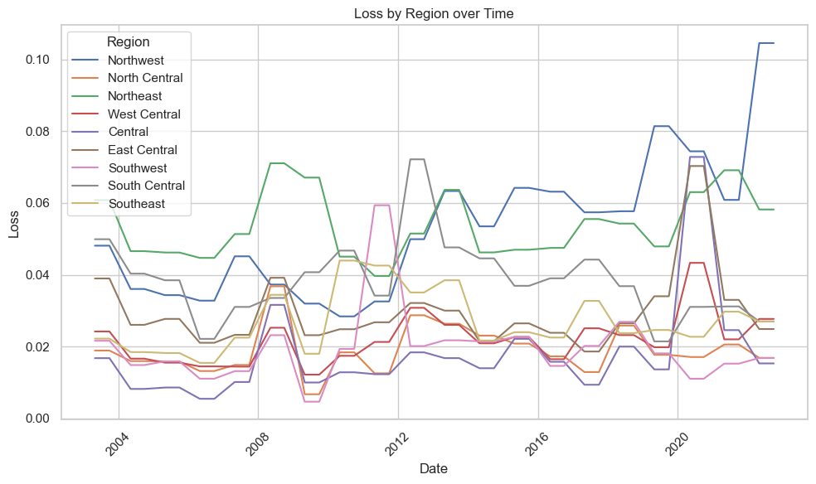
Background
Why predict crop loss instead of crop yields?
Proactive Risk Management: Predicting crop failures early allows for insurance adjusting and mitigation strategies, reducing losses (Schillerberg & Tian, 2023)
Food Security: Improved supply planning and price stability through reliable crop loss forecasts (Pandey & Mishra, 2024).
State Library of Iowa, 2025
Notes:
Massive Acreage: Roughly 13 million acres of farmland in Iowa are planted with corn each year, which is more than any other state.
National Food & Energy Security: Iowa corn is essential not just for food but for biofuel production (ethanol) and livestock feed, which influences prices and availability nationwide.
Economic Impact: Corn farming is a major driver of Iowa’s economy, supporting not just farmers but also ethanol plants, livestock feed industries, and global export markets.
Proactive Risk Management: Early identification of potential crop failures enables stakeholders to implement timely mitigation strategies—such as adjusting insurance policies or diversifying crops—to minimize economic losses.
Strengthening Food Security: Accurate crop loss forecasts enhance supply chain planning and food distribution, helping to stabilize food availability and prices for both local communities and global markets.
Schillerberg, T., & Tian, D. (2023). Changes in crop failures and their predictions with agroclimatic conditions: Analysis based on earth observations and machine learning over global croplands. Agricultural and Forest Meteorology, 340, 109620.
Pandey, D. K., & Mishra, R. (2024). Towards sustainable agriculture: Harnessing AI for global food security. Artificial Intelligence in Agriculture.

Slide 4
Goals
Develop a machine learning model for predicting corn crop loss in Iowa.
Identify satellite datasets sensitive to crop stress indicators.
Compile annotated time-series datasets for Iowa, including historical crop outcomes and seasonal descriptors.
Integrate model predictions with economic data to assess the potential economic impact of crop loss.

Slide 5
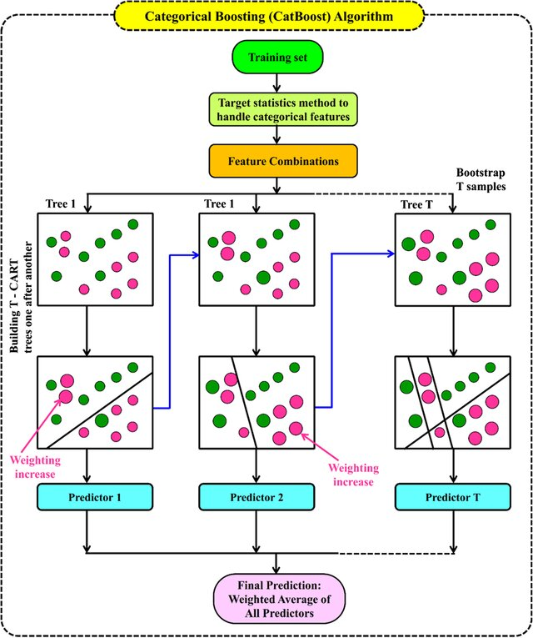
Methods
Catboost model
Gradient boosted tree model developed for performing well with categorical tabular data.
Simple, fast, interpretable.
Target: Crop loss % (Iowa Agricultural Statistics)
Predictive features:
Latitude & Longitude
Climate features (Oregon State’s PRISM Network)
Daily total precipitation
Daily mean temperature
Daily maximum vapor pressure deficit
Light reflectance (NASA MODIS Satellite)
Normalized Difference Vegetation Index (NDVI)
Enhanced Vegetation Index (EVI)
Normalized Difference Water Index (NDWI)
Pandey et al., 2023

Slide 6
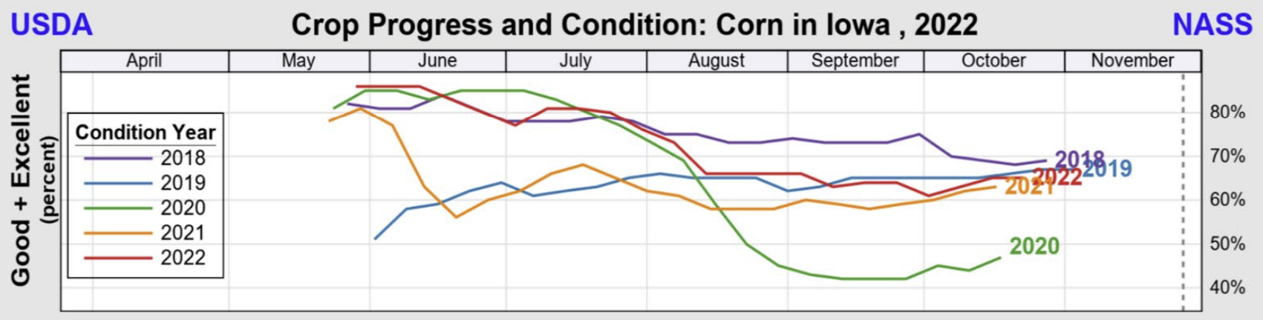
Methods
National Agriculture Statistics Survey, 2023

Slide 7
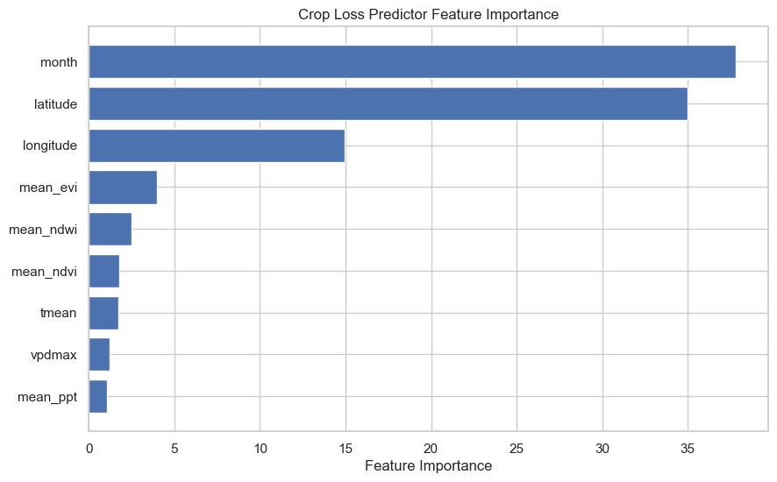
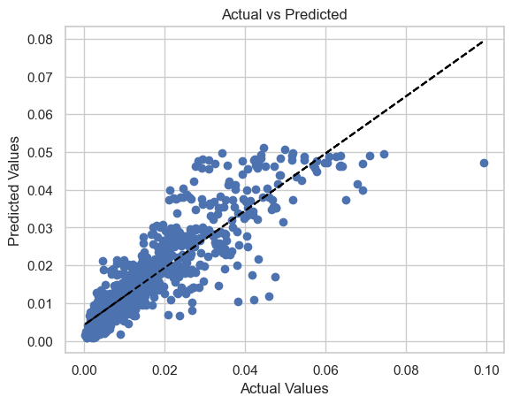
Results - Model Performance
R²: 0.776
MAE: 0.004
Notes:
https://www.weather.gov/images/dmx/Climate/Annual_Precipitation.png

Slide 8
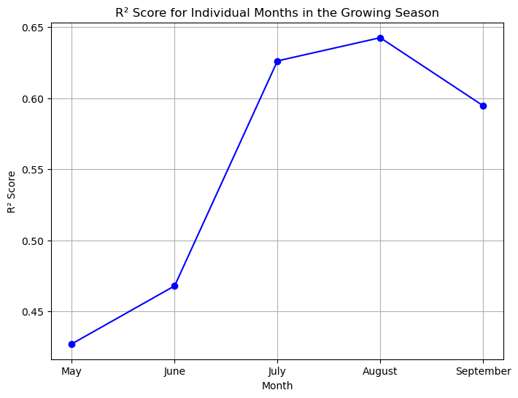
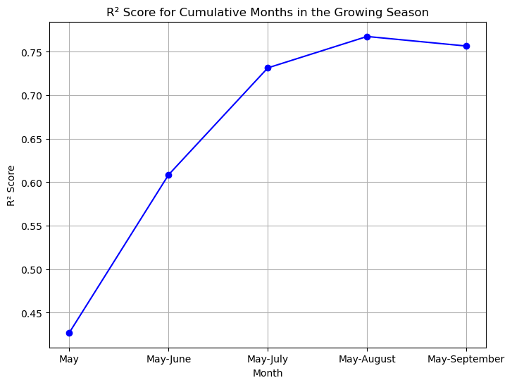
Results - Model Performance Over Growing Season

Slide 9
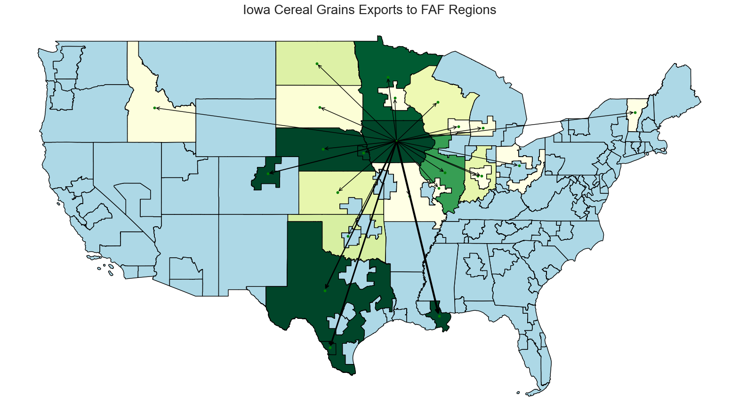
Results - Impacted Domestic Regions
In 2017, there was 2.95% of total Iowa planted corn crop lost.
2017 total cereal grains from Iowa value domestic trade = $124,427,108,138 (~$124B)
2.95% loss in $ = $3,670,599,690 (~$3.6B)
Most impacted regions:
Iowa: 65% [Ethanol, Livestock]
New Orleans Metro: 14.4% [Export]
Laredo Metro: 9.57% [Export]
Rural Texas: 6.09% [Livestock]
Denver Metro: 3.18% [Livestock]
Nebraska Rural: 0.57% [Livestock]
Omaha Metro: 0.42% [Livestock]
Hwang et al., 2021
Notes:
harvested : 12970600 acres
Planted : 12588200acres

Slide 10
Takeaways
The CatBoost model can reliably predict corn crop loss by mid-season, providing valuable insights for government planning and supply chain management.
We have made substantial progress towards developing a generalizable crop loss prediction model.
While many models predict crop yield, our focus on predicting crop loss is designed to provide information on how growing conditions may affect crop health.
Here we present a version of this model that does not include historical loss as a feature. Our goal is to develop the model so that current conditions predict future crop loss.

Slide 11
Next Steps
Transition to a machine learning model better suited for time-series forecasting with sequential data:
Long Short-Term Memory (LSTM) Neural Network.
Collect and incorporate features that represent natural hazards:
Palmer Drought Index, tornado history, flood prevalence, FEMA National Risk Index, etc.
Test model on finer spatial resolutions (i.e. county level or field level) and larger sample area (i.e. the entire United States).

Slide 12

Acknowledgments
The Arizona NASA Space Grant Consortium (AZSGC) for funding this research and providing the opportunity to present this research.
Eric Sjöstedt and Dr. Richard Rushforth (UofA Space Grant alum) for their mentorship and guidance.
Dr. Ben Ruddell, Sean Koenig, Kendall Smith, and the rest of the NAU Complex Systems and Informatics Laboratory (CSIL).

Slide 13
References
Dean, A.N., Hodgson, E.W., Rieck-Hinz, A. and Anderson, M., 2021. Needs assessment for corn insect pest management in Iowa. Journal of Integrated Pest Management, 12(1), p.27.
Hwang, H.L., Lim, H., Chin, S.M., Uddin, M., Biehl, A., Xie, F., Hargrove, S., Liu, Y. and Wang, R., 2021. Freight Analysis Framework Version 5 (FAF5) Base Year 2017 Data Development Technical Report (No. ORNL/TM-2021/2154). Oak Ridge National Laboratory (ORNL), Oak Ridge, TN (United States).
National Agricultural Statistics Survey (NASS)., 2023. USDA's National Agricultural Statistics Service Iowa Field Office. Accessible from: https://www.nass.usda.gov/Statistics_by_State/Iowa/index.php
Pandey, M., Karbasi, M., Jamei, M., Malik, A. and Pu, J.H., 2023. A comprehensive experimental and computational investigation on estimation of scour depth at bridge abutment: emerging ensemble intelligent systems. Water Resources Management, 37(9), pp.3745-3767.
State Library of Iowa. 2025. Iowa Annual Agriculture Statistics. Accessible from: https://publications.iowa.gov/cgi/search/simple?q=+Iowa+Agricultural+Statistics&_action_search=Search&_action_search=Search&_order=bytitle&basic_srchtype=ALL&_satisfyall=ALL
Iowa State University, Agricultural Policy Review. URL: https://agpolicyreview.card.iastate.edu/spring-2021/iowas-role-us-agriculture
Iowa Corn Growers Association (ICGA). URL: https://www.iowacorn.org/corn-facts-faq/
Schillerberg, T., & Tian, D. 2023. Changes in crop failures and their predictions with agroclimatic conditions: Analysis based on earth observations and machine learning over global croplands. Agricultural and Forest Meteorology, 340, 109620.
Pandey, D. K., & Mishra, R. 2024. Towards sustainable agriculture: Harnessing AI for global food security. Artificial Intelligence in Agriculture.

